Slide 1
DUMP of mm talk

Slide 3
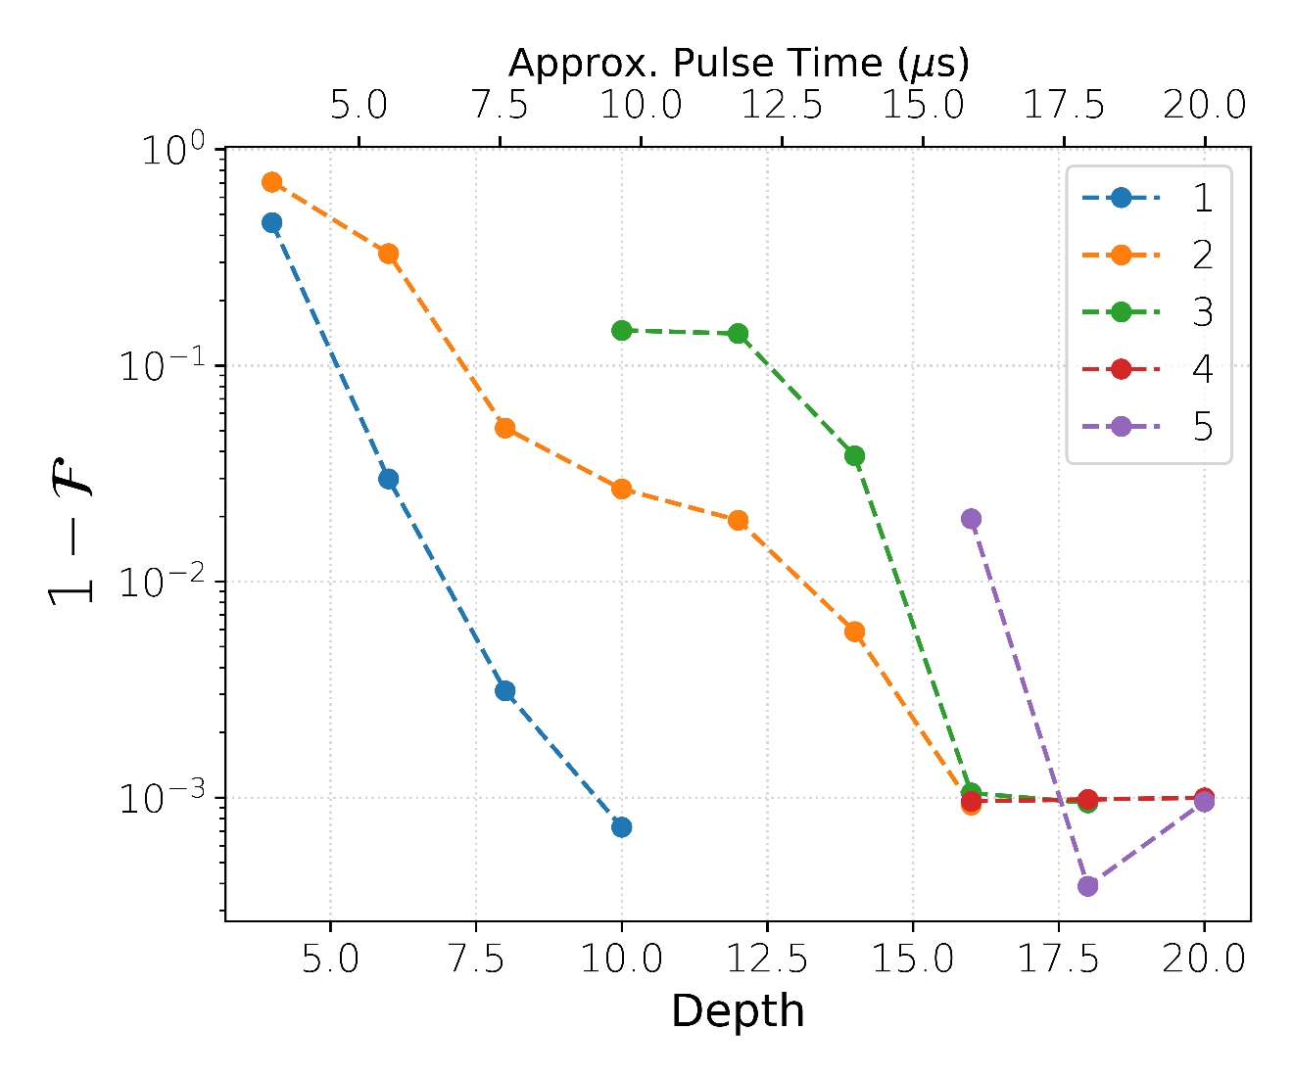
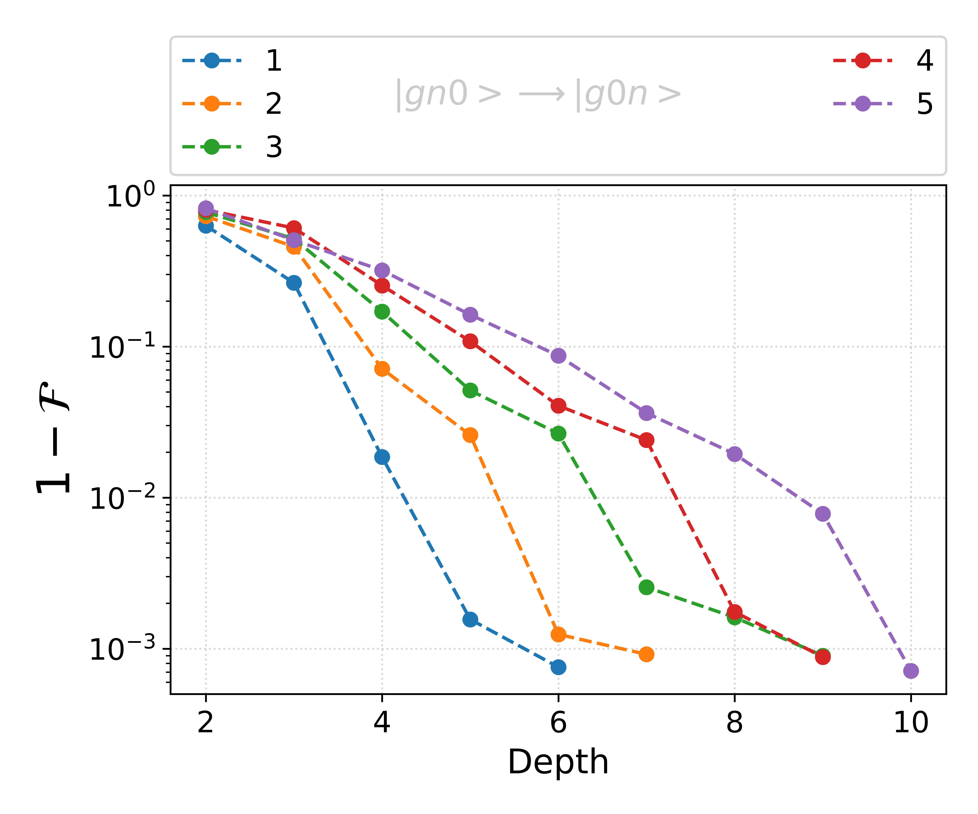
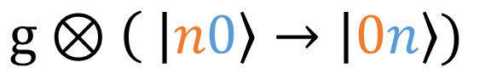
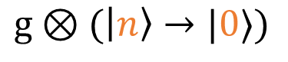
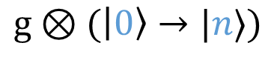
Two Mode ECD: State Transfer
$$g⊗(\left|0\right\rangle →|n⟩)$$
$$g⊗\left( \left|n0\right\rangle → | 0n\right\rangle )$$
$$g⊗(\left|n\right\rangle →|0⟩)$$
Notes:
Compare with Single Mode ECD Results

Slide 4
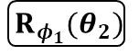
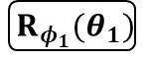
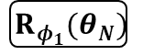
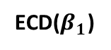
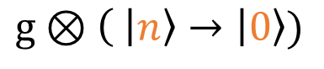
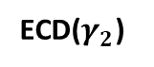
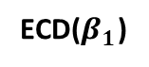
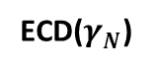
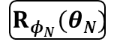
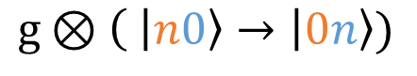
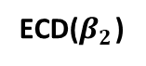


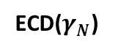
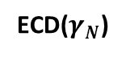
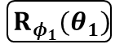
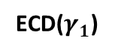
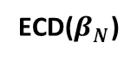
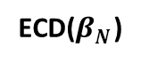
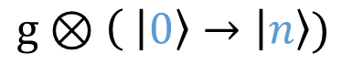
Two Mode ECD: State Transfer
$$g⊗\left( \left|n0\right\rangle → | 0n\right\rangle )$$
Mode 2
ECD($γ_{1}$)
ECD($γ_{2}$)
ECD($γ_{N}$)
Mode 1
ECD($β_{1}$)
ECD($β_{2}$)
ECD($β_{N}$)
Qubit
$${ R}_{φ_{1}}(θ_{1})$$
$${ R}_{φ_{1}}(θ_{2})$$
$${ R}_{φ_{1}}(θ_{N})$$
$$g⊗\left( \left|n\right\rangle → | 0\right\rangle )$$
$$g⊗\left( \left|0\right\rangle → | n\right\rangle )$$
Mode 2
ECD($γ_{N}$)
ECD($γ_{N}$)
Mode 1
ECD($β_{1}$)
ECD($β_{N}$)
Qubit
$${ R}_{φ_{1}}(θ_{1})$$
$${ R}_{φ_{N}}(θ_{N})$$
$${ R}_{φ_{1}}(θ_{1})$$
$${ R}_{φ_{1}}(θ_{N})$$

Slide 5
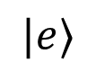
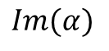
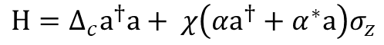
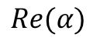
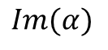
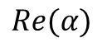
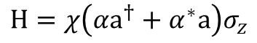
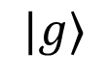
Circle Grape
$$|g⟩$$
$$H=χ\left(αa^{†}+α^{∗}a\right)σ_{z}$$
$$|e⟩$$
$$Im(α)$$
Qubit Drive Optimized
Cavity mode always driven far from origin in phase space
Cavity drives detuned
$$Re(α)$$
$$H=Δ_{c}a^{†}a+ χ\left(αa^{†}+α^{∗}a\right)σ_{z}$$
$$Im(α)$$
Rotate in circle because of detuning; is this a spiral?
$$Re(α)$$
Elder S., et al. Bulletin of the American Physical Society 66 (2021)

Slide 6
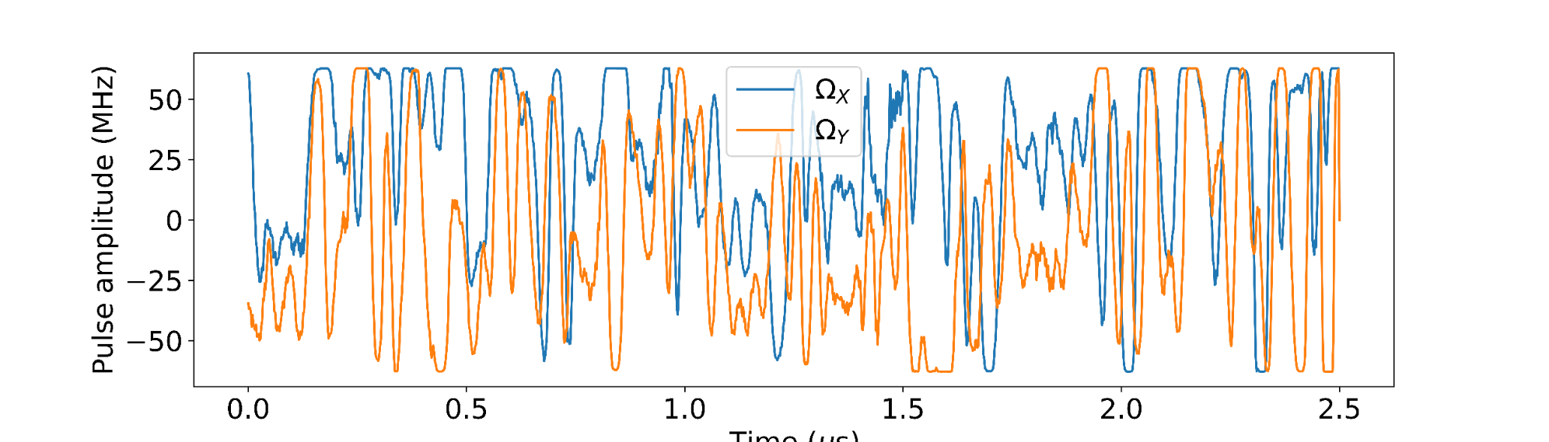
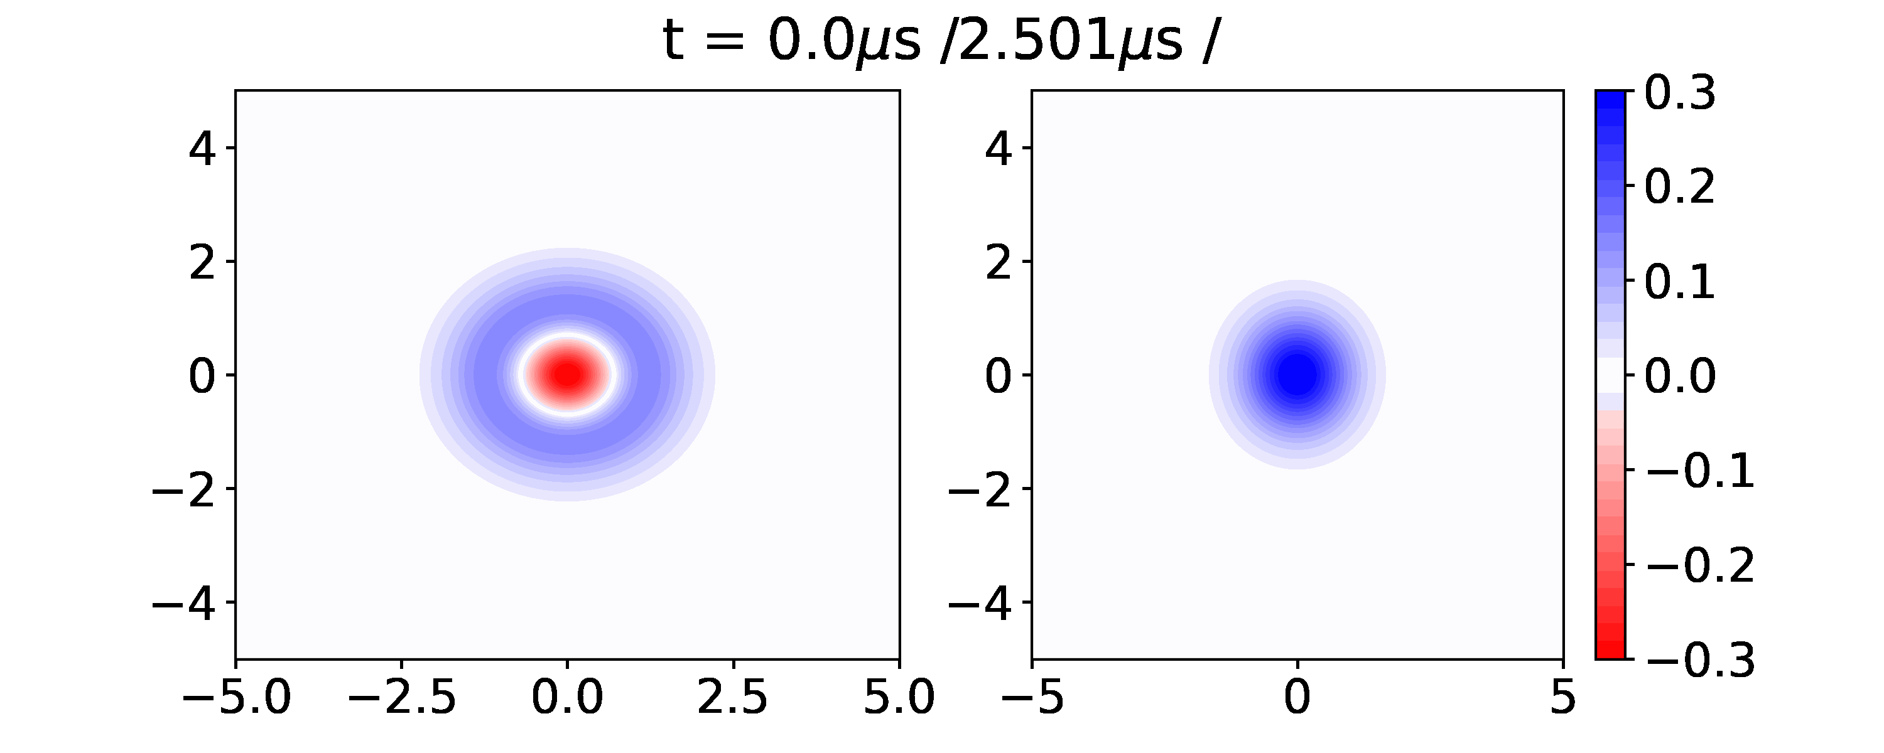
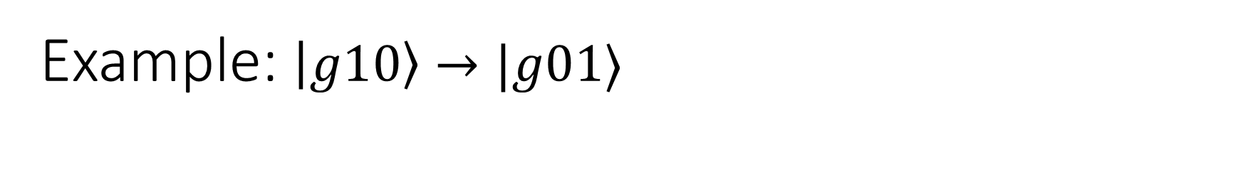
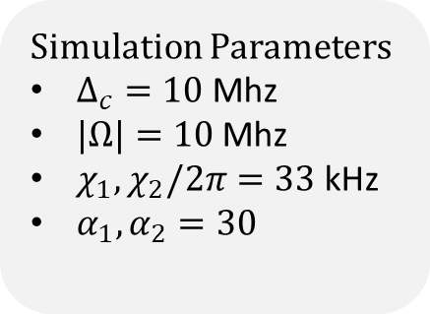
Example: $\left|g10\right\rangle →|g01⟩$
Simulation Parameters
$Δ_{c}=10$Mhz
$|Ω|=10$Mhz
$χ_{1}, χ_{2}/2π=33$kHz
$α_{1}, α_{2}=30$

Slide 7
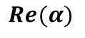
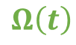
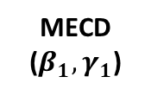
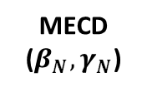
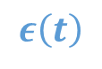
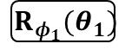
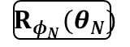
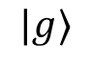
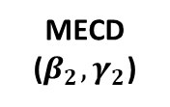
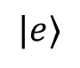
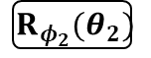
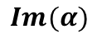
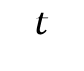
Workflow
Mode 2
MECD ($β_{1},γ_{1}$)
MECD ($β_{2},γ_{2}$)
MECD ($β_{N},γ_{N}$)
Parameter Optimization
Mode 1
Qubit
$${ R}_{φ_{1}}(θ_{1})$$
$${ R}_{φ_{2}}(θ_{2})$$
$${ R}_{φ_{N}}(θ_{N})$$
$$ε\left(t\right)$$
$$Ω\left(t\right)$$
Pulse
Optimization
$$t$$
$$|g⟩$$
$$|e⟩$$
$$Im(α)$$
$$Re(α)$$

Slide 8
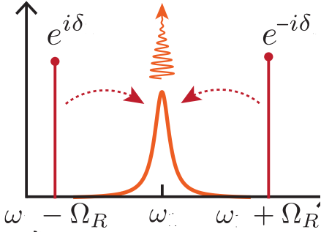
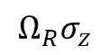












Sideband Drives Method
Since $α$ oscillatory,
$$H=χa^{+}aσ_{z }+χ\left(αa^{+}+α^{∗}a\right)σ_{z}+χ{\left|α\right|}^{2}σ_{z}+Ω_{R}σ_{x}$$
$$ω=0$$
$$ω=Ω_{R }$$
$$ω={2Ω}_{R }$$
$$ε\left(t\right)∝α_{0}sin⁡(Ω_{R}t+δ)$$
Frame Transformations:
$σ_{x}↔σ_{z}$
Rotating Frame of the qubit
t
$$δ$$
$$Ω_{R}σ_{z}$$
$$Ω_{R}σ_{z}$$
$$α\left(t\right)∝α_{0}cos(Ω_{R}t+δ)$$
$$H=χα_{0}\left(a^{+}+a\right)⊗(σ_{x}\cos{δ+σ_{y}\sin{δ )}} + …$$
t
$$cos⁡(δ)$$
$$ω=0$$
$$ω≥ Ω_{R}$$
Shay Hacohen-Gourgy, …, Irfan Siddiqi. Nature 538-7626 (2016).

Slide 9










Echoing in ECD
$$α\left(t\right)$$
$$Ω(t)$$
t
Not completely
echoed out !
$$χa^{+}aσ_{z}$$
$$χa^{+}a(−σ_{z})$$
Echo
$$χ\left(αa^{+}+α^{∗}a\right)σ_{z}$$
$$χ\left(αa^{+}+α^{∗}a\right)σ_{z}$$
$$χ{|α|}^{2}σ_{z}$$
$$χ{|α|}^{2}{(−σ}_{z} )$$
A. Eickbusch, ..., R. Schoelkopf, M. Devoret. ArXiv preprint arXiv:2111.06414 (2021)

Slide 10













Conclusions and Future Work
$$χα_{0}$$
Suppression of cross-talk errors
Achieve >0.999 fidelity for fock state transfer using Double ECD
Future Work:
Unite ECD with Sidebands scheme and CNOD
$$χ$$
$$f$$
$$e$$
$$χ$$
$$g$$
$$χ$$
Mode 1
ECD($γ$)
Mode 2
ECD($β$)
Qubit
$$R_{φ}(θ)$$

Slide 11



Circle Grape Results
$$g⊗(\left|0\right\rangle →|n⟩)$$
$$g⊗\left( \left|n0\right\rangle → | 0n\right\rangle )$$
$$g⊗(\left|n\right\rangle →|0⟩)$$

Slide 12


Uniting with other schemes: Dealing with Unwanted Terms
The displaced frame transformation, however, divides the initial ac-Stark shift term into the following 3 terms
Sideband Drives
Make terms oscillate at different frequencies
Invoke RWA in a frame where only desired term is stationary
Echoed Cond. Displacements
Terms have different no. of α’s but only a single $σ_{z}$
Clever flipping of α and $σ_{z}$ can echo out unwanted terms

Slide 13

Transmon Relaxation
Reduction in Errors if use better qubits i.e. fluxonium

Slide 14











ECD
Circle Grape
$$α_{0}$$
$$ε\left(t\right)$$
$ε\left(t\right)=Δ_{c}∗α_{0}$
$$t$$
$$\frac{t_{w }}{2}$$
$$t$$
$$Ω\left(t\right)$$
$$π$$
$$R_{φ}(θ)$$
Optimizer
$$\vec{β}=α_{0}\vec{t_{w}} \vec{φ} , \vec{θ}$$
Optimizer
$$Ω_{x}\left(t\right), Ω_{y}(t)$$

Slide 15


Comparing Grape and MECD
ECD
Circle Grape

Slide 16










Motivation
Goal: Enact gates on cavity modes
Typical Schemes use $χa^{†}aσ_{z}$
Coupling to the lossy ancilla reduces mode coherence
$$T_{1}^{cav}≤ \frac{Δ^{2}}{g^{2}}T_{1}^{q} \sim \frac{2α}{χ}T_{1}^{q}$$
$$χ$$
Increase $χ$ for faster gates
$$f$$
$$χ$$
$$e$$
$$g$$
$$χ$$
Decrease $χ$ for better mode
coherence
Notes:
1. Transmon offers the desired non-linearity
2. Schemes such as SNAP and Grape use the dispersive interaction
3. Coupling introduces loss into the cavity --

Slide 17

Circle Grape
$$H=χa^{+}aσ_{z }+χ\left(α_{0}a^{+}+α_{0}^{∗}a\right)σ_{z}+$$
$$χ{\left|α_{0}\right|}^{2}σ_{z}+Ω(t)σ_{x}$$
Sent to Optimizer
Continuous version
Currently uses simulatenous drives
Phase Space Dynamics

Slide 18






Multimode ECD
Mode 1
MECD ($β,γ$)
Mode 1
ECD($γ$)
$$=$$
Mode 2
Mode 2
ECD($β$)
$$R_{φ}(θ)$$
Qubit
Qubit
$$R_{φ}(θ)$$
$$MECD\left(β, γ\right)=\left(\begin{matrix}D_{1}\left(−\frac{β}{2}\right)D_{2}\left(\frac{γ}{2} \right) & 0 \\ 0 & D_{1}\left(\frac{β}{2}\right)D_{2}\left(−\frac{γ}{2}\right)\end{matrix}\right)$$
Notes:
$$MECD\left(β, γ\right)=D_{1}\left(−\frac{β}{2}\right)D_{2}\left(\frac{γ}{2} \right) \left|g\right\rangle \left\langle g\right|+D_{1}\left(\frac{β}{2}\right)D_{2}\left(−\frac{γ}{2}\right) \left|e\right\rangle \left\langle e\right|$$
Not simultaneously driving each mode to prevent heating of modes (cite CNOD paper)
Downside: speed of gates is $1/χα_{0}$

Slide 19



Multimode ECD
Mode 1
Mode 1
ECD($γ$)
MECD ($β,γ$)
$$=$$
Mode 2
Mode 2
ECD($β$)
Universal Control for Two Modes
Asimultaneous drives to prevent heating of modes [1,2] and amplification of cross kerr terms
Qubit
Qubit
[1] Eickbusch, Alec , et al. W34. 00005. APS March Meeting (2022).
[2] Diringer, Asaf A., et al. arXiv preprint arXiv:2301.09831 (2023).

Slide 20


Prev. Work: Echoed Cond. Disp.
Parameter Optimization
$$ECD\left(β\right)=D\left(\frac{β}{2}\right) \left|e\right\rangle \left\langle g\right|+D\left(−\frac{β}{2}\right) \left|g\right\rangle \left\langle e\right|$$
Pulse Optimization
A. Eickbusch, ..., R. Schoelkopf, M. Devoret. ArXiv preprint arXiv:2111.06414 (2021)
Notes:
Parameter Optimization
- Pulse Optimization
Echo out unwanted terms$(χ{|α|}^{2}σ_{z}$ and $χa^{+}aσ_{z}$) by constructing symmetric pulses for cavity drive.
Use semi-classical phase space treajectory method to find pulses which realize target displacements $\vec{β}$

Slide 21








Prev. Work: Echoed Cond. Disp.
Parameter Optimization
Pulse Optimization
$$ε\left(t\right)$$
$$Ω\left(t\right)$$
$$t$$
$$α\left(t\right)$$
t
$$|g⟩$$
$$|e⟩$$
$$Im(α)$$
$$Re(α)$$
A. Eickbusch, ..., R. Schoelkopf, M. Devoret. ArXiv preprint arXiv:2111.06414 (2021)
Notes:
Parameter Optimization
- Pulse Optimization
Echo out unwanted terms$(χ{|α|}^{2}σ_{z}$ and $χa^{+}aσ_{z}$) by constructing symmetric pulses for cavity drive.
Use semi-classical phase space treajectory method to find pulses which realize target displacements $\vec{β}$

Slide 22








Two Mode ECD : Unwanted Cross Kerr Terms
Displaced Frame Transformation
$$χ_{ab}a^{+}a b^{+}b$$
$$χ_{ab}{(a}^{+}+α^{∗})(a+α)(b^{+}+β^{∗})(b+β)$$
Terms of form :
How to avoid :
$$χ_{ab}αβ a^{+}b^{+}$$
$α, β$should not be simultaneously nonzero
$$χ_{ab}{\left|α\right|}^{2}β b^{+}$$
Echoed out when $β$ flips
Make $χ_{ab}≪χ_{a}, χ_{b}≈10$kHz
Note $χ_{ab}=\sqrt{κ_{a}κ_{b}}=\frac{χ_{a}χ_{b}}{α′}≈0.33$Hz … good!
($α^{′}≤$ 300 MHz for transmons)
$χ_{ab}{\left|α\right|}^{2}b^{+}b$

Slide 23


$$ε\left(t\right)$$
$$Ω\left(t\right)$$
$$|g⟩$$
$$t$$
$$|e⟩$$
$$Im(α)$$
$$Re(α)$$

Slide 24


Slide 25








Large Displacements
$$f$$
$$e$$
Conditional Displacement Gates:
- Use Large Displacements to enhance effective interaction strength
$$g$$
$$χa^{†}aσ_{z}$$
$$χ{ (α_{0}a}^{†}+α_{0}^{⋆}a) σ_{z}$$
$$D(α_{0})$$
$$χα_{0}$$
Advantage in Multimode Context:
Gate Speed ${ g}_{gate}=χα_{0}$
Coherent Errors: $ε_{coh}=\frac{Nχ}{g_{gate}}=\frac{N}{α_{0}}$
$$χ$$
$$f$$
$$e$$
$$χ$$
$$g$$
$$χ$$
$N$ non-target modes
Hacohen-Gourgy, S., Martin, L., Flurin, E. et al. Nature 538, 491–494 (2016).
Eickbusch, A., Sivak, V., Ding, A.Z. et al. Nat. Phys. 18, 1464–1469 (2022)

Slide 26





Echoed Conditional Displacements
Symmetric pulse sequences to isolate conditional displacement term in Hamiltonian.
Universal control of single mode coupled to qubit with gate set $\{ECD\left(β\right), R_{φ}(θ)\}$
Mode
ECD($β$)
$$D\left(\frac{β}{2}\right) \left|e\right\rangle \left\langle g\right|+D\left(−\frac{β}{2}\right) \left|g\right\rangle \left\langle e\right|$$
$$=$$
Qubit
$$α_{0}$$
$$ε\left(t\right)$$
$$t$$
$$\frac{β}{2α_{0}}$$
$$Ω\left(t\right)$$
$$π$$
Eickbusch, A., Sivak, V., Ding, A.Z. et al. Nat. Phys. 18, 1464–1469 (2022)

Slide 27











Echoed Conditional Gates
$$χ\left(a^{†}+α^{∗}\right)\left(a+α\right)σ_{z}$$
$$=$$
$$χ{ (αa}^{†}+α^{∗}a) σ_{z}$$
$$χ{\left|α\right|}^{2}σ_{z}$$
$$χa^{†}aσ_{z}$$
$$+$$
$$+$$
$$α_{0}$$
$$ε\left(t\right)$$
Mode
ECD($β$)
$$D\left(\frac{β}{2}\right) \left|e\right\rangle \left\langle g\right|+D\left(−\frac{β}{2}\right) \left|g\right\rangle \left\langle e\right|$$
$$t$$
$$=$$
$$=$$
$$\frac{β}{2α_{0}}$$
Qubit
$$Ω\left(t\right)$$
$$π$$
Eickbusch, A., Sivak, V., Ding, A.Z. et al. Nat. Phys. 18, 1464–1469 (2022)

Slide 28





$$f$$
$$e$$
$$Ω\left(t\right)$$
$$g$$

